Slide 1
Malignant tumors in uterus
Department of Obstetrics and Gynaecology

Slide 2
Objectives
To identify the risk factors for endometrial Carcinoma (CA)
Recognize clinical presentation of endometrial malignancy
To describe the evaluation and the treatment of endometrial Ca
Uterine sarcoma : overview

Slide 3
Endometrial Carcinoma
A common gynaecological malignancy
Disease of postmenopausal women
(>90%), mean age is 61 yrs.
Rare before 40 yrs. <5% (2/100,000)

Slide 4
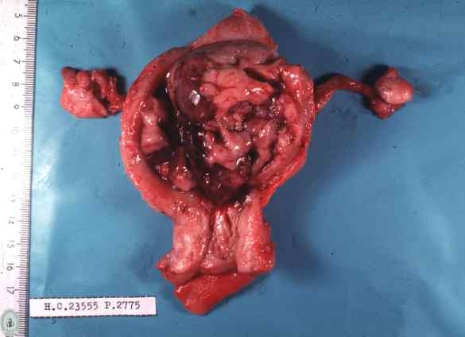
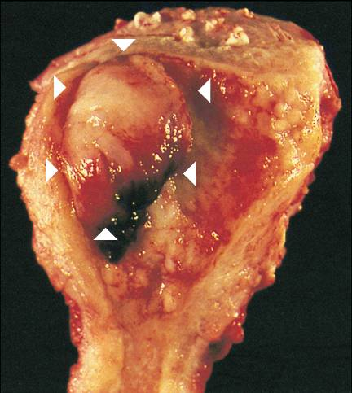
Endometrial cancer

Slide 5
Etiology of endometrial CA
High level of estrogen or prolonged estrogen influence
excessive endogenous estrogen
exogenous estrogen
Hereditary predisposition

Slide 6
How does Estrogen cause Endometrial CA?
Estrogen causes endometrial hyperplasia
With high rate of cell turnover, DNA repair process might fail; apoptosis also fail; cells with malignant potential escape surveillance & grow.

Slide 7
Exogenous Estrogen
Hormone replacement therapy
Unopposed estrogen activity
Estrogen only HRT
Tamoxifen
SERM

Slide 8
Endogenous Estrogen
Anovulation with PCOS
Cirrhosis of the liver
Estrogen secreting tumours
Ovarian, adrenal

Slide 9
PCOS and endometrial Ca
Anovulation - continuous estrogen dominant proliferative phase
Hyperinsulinemia

Slide 10
Endometrial hyperplasia
Simple Malignancy risk
Without atypia 1%
With atypia 8%
Complex
Without atypia 3%
With atypia 29%

Slide 11
Hereditary predisposition & Endometrial CA
Lynch syndrome – HNPCC
Life time risk
Colorectal - 40%
Endometrial - 50%
Ovarian - 10%
Gastric - 5 %
Biliary - 15%
Urinary - 5%

Slide 12
Other associations
Obesity
Diabetes
White
High socio-economic state
Nullipara
Early menarche
Late menopause

Slide 13
Classification
Two cohorts of endometrial malignancies
Type 1
Type 2

Slide 14
characteristics | Type 1 | Type 2
Age | 55-65 years | 65-75 years
Clinical setting | Unopposed estrogen Obesity HT DM | Atrophy Thin physique
Morphology | endometroid | Serous Clear cell Mix mullerian tumor
precursor | Hyperplasia | Endometrial Intraepithelial carcinoma
Behavior | Indolent Spread via lymphatics | Aggressive Intraperitoneal and lymphatics spread

Slide 15
Presentation
PMB (Post menopausal bleeding)
Vaginal discharge or pyometra
Irregular vaginal bleeding.
Pelvic pain.
Symptoms due to metastases.
(Haematuria, PR bleeding..)

Slide 16
Examination
Obesity - BMI.
Signs of PCOD
LN- supraclavicular, inguinal
Vaginal metastasis.
Enlarged uterus
Adnexal or, parametrial involvement

Slide 17
How shall we investigate ?
TVS
Endometrial biopsy.
MRI.
Other Ix-
FBC
BU/SE
UFR
CA125
Chest X ray
IVU if ureteric obstructions are suspected

Slide 18
Trans vaginal scan
Endometrial thickness (> 4-5m)
irregular endometrial outline.
3. fluids in the cavity.
In a woman with post menopausal bleeding, if the ET is < 4mm Endometrial malignancy is unlikely

Slide 19
MRI
Better than USS and CT to detect
Myometrial involvement
Cervical involvement
Pelvic lymph nodes
Both MRI/CT miss small LN

Slide 20
Endometrial sampling
Hysteroscopy(Gold standard)
In patient / outpatient
* Visualization of polyp/ fibroid/growth
* Directed biopsy - Commonly GA
Dilatation and Curettage
Pipelle Sampling
Details will be done in DUB lecture

Slide 21
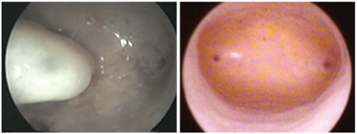
Hysteroscopy
Hysteroscopy has a sensitivity and specificity for identifying endometrial cancer of 86% and 99%, respectively.

Slide 22
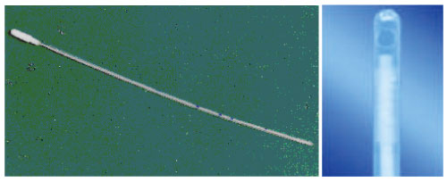
Endometrial Pipelle sampling
The Pipelle© biopsy instrument is a fine-bore plastic instrument with a curette-like tip and a central plunger, which creates a vacuum when pulled.
has a sensitivity and specificity of 68–81% and 99–100% for identifying endometrial hyperplasia and endometrial cancer

Slide 23
Histological subtypes in endometrial cancer
Type | % of cases
Endometrioid adenocarcinoma | 50-60
Adenosquamous | 6-8
Serous papillary | 18
Sarcomas/leiomyosarcomas | 3-5
Carcinosarcomas | 2-3
Clear cell | 1-6

Slide 24
Staging of Endometrial CA
1 confined to uterus
Ia – Endometrium
Ib – 50% of myometrium
Ic - >50% of myometrium
2 spread to cervix
2a – cervical glands
2b – cervical stroma

Slide 25
Staging of Endometrial CA
3. Adnexy , vagina , LN involved (pelvic & para-aortic)
3a – adnexy, positive ascites
3b – vaginal
3c - LN +
4. Distant
4a – bladder bowel mucosa
4b – distant

Slide 26
Overall 5 year survival of Endometrial malignancy
All together - 75%
Papillary - 30%
Clear cell - 40%

Slide 27
Prognostic factors of endometrial CA
Stage
Depth of Myometrial invasion
Degree of differentiation
Ploidy status
Tumour size
Age

Slide 28
Prognostic factors
LN involvement
Histological subtype
Steroid receptor status
Peritoneal cytology ( 10 % of Stage I has positive)

Slide 29
5 Year survival according to stage of the disease
I - 80 %
II - 70 %
III - 40 %
IV - 25 %
Overall - 75 %

Slide 30
Management of endometrial carcinoma
Surgery
Radiotherapy
Progesterone
Chemotherapy

Slide 31
Surgery - Endometrial CA
TAH and BSO
±Lymphadenectomy

Slide 32
Surgery for endometrial CA operative technique
Subumbilical midline incision
Peritoneal cytology (around uterus, bladder, POD )
Thorough search of peritoneal cavity
( uterine, adnexa, retroperitoneal nodes, omentum, liver )
Proceed with surgery – uterus is cut open & see invasion > ½; if lymphadenectomy is considered

Slide 33
Management Stage I
TAH + BSO
± pelvic lymphadenectomy
In high risk for LN involvement
>grade 2
>1/2 myometrium involved
Serous & clear cell

Slide 34
Radiotherapy & Endo-CA stage I
Evidence
No survival advantage
But vault brachytherapy - reduce vault recurrence
Teletheraphy – reduce pelvic recurrence.
No radiotherapy necessary in women under 60 yrs, stage 1 ( < 50% myometrial invasion) with grade 1 or 2 ( ASTEC trial)

Slide 35
Stage II - surgery + post-op radiotherapy
Radical hysterectomy+ BSO + Omentectomy+ Pelvic lymphadenectomy
Post-op radiotherapy to–vault
OR
Presurgical radiotherapy followed up by hysterectomy in 6-10wks.

Slide 36
Stage III - Management
Radical Radiotherapy
Surgery : excision of all macroscopic disease and enlarged lymph nodes if possible
+ post-op radiotherapy

Slide 37
Stage - IV
Common site - lung
Primary aim is palliation

Slide 38
Radiotherapy & Endometrial CA
Post- operative;
To sterilize LN
To prevent vaginal vault recurrence.
Types;
Intracavitatory
External beam

Slide 39
Progesterone & endometrial CA
Stage IV Endometrial Ca
Recurrent Endometrial Ca
Read

Slide 40
Recurrence
50% recurrence occur within 2 years of treatment.
Most common site of extra pelvic metastasis is lungs.
Isolated vaginal recurrence has the best prognosis.
Late recurrence – progesterone therapy.

Slide 41
Uterine sarcoma
Account for 3% (Rare) of uterine malignancies.
15% all deaths from uterine cancer.
Usually rapidly growing tumour with poor prognosis

Slide 42
Leiomyosarcoma
1/3 rd of uterine sarcomas are leiomyosarcomas.
Present with postmenopausal bleeding, irregular vaginal bleeding.vaginal discharge, abdominal or pelvic pain,wight loss or abnormal cytology.
Should be excluded in a rapidly growing uterine mass or fibroid uterus.

Slide 43
Leiomyosarcoma
Treatment of choice is TAH +BSO.

Slide 44
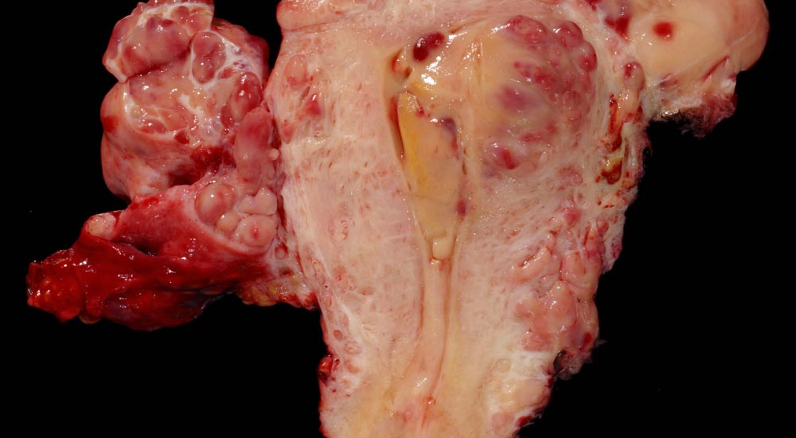
Uterine stromal sarcoma

Slide 45
THANK YOU

